Slide 1
INTRODUCTION TO MARKOV MODELS

Slide 2
OUTLINE
Markov model
Hidden Markov model (HMM)
Example:

Slide 3
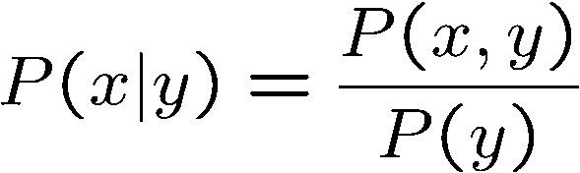

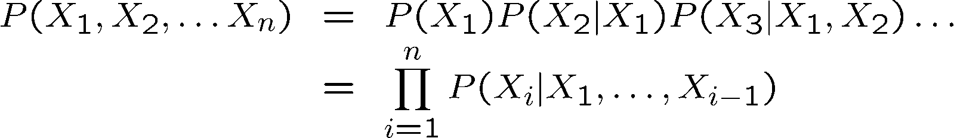

Probability Recap
Conditional probability
Product rule
Chain rule
X, Y independent if and only if:
X and Y are conditionally independent given Z if and only if:

Slide 4
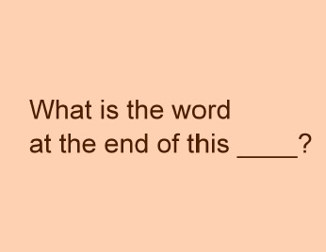

MOTIVATION

Slide 5
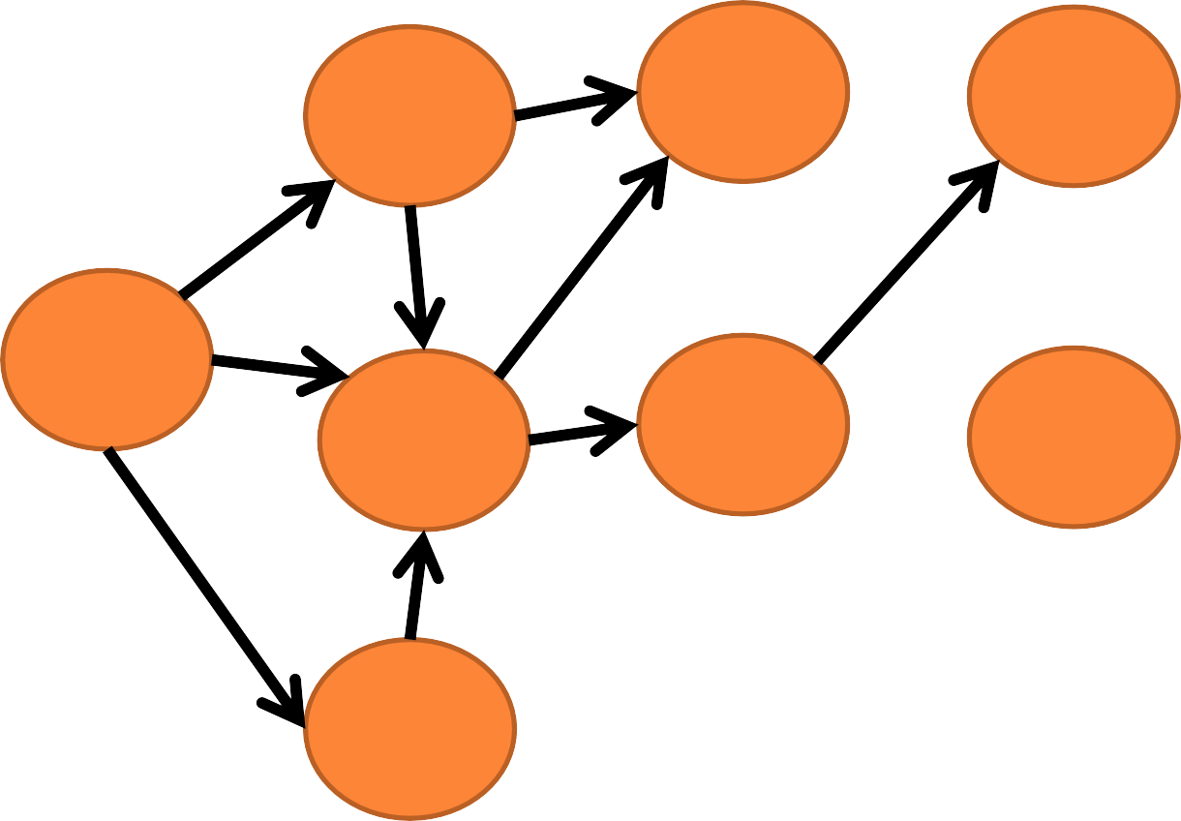
MARKOV CHAIN
P
P
sentence
next
of
0.6
is
P
P
P P
P
P
P
P
paragraph
P
0.05
What
the
word
this
P
P
0.05
P
P
line
P
P
P
are
end
at
0.3
message
P

Slide 6
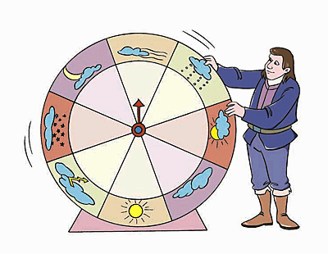
MARKOV CHAIN: WEATHER EXAMPLE
Design a Markov Chain to predict the weather of tomorrow using previous information of the past days.
Our model has only 3 states:
𝑆 = 𝑆₁, 𝑆₂, 𝑆₃ , and the name of each state is 𝑆₁ = 𝑆𝑢𝑛𝑛𝑦 ,
𝑆₂ = 𝑅𝑎𝑖𝑛𝑦, 𝑆₃ = 𝐶𝑙𝑜𝑢𝑑𝑦.
To establish the transition probabilities relationship between states we will need to collect data.

Slide 7
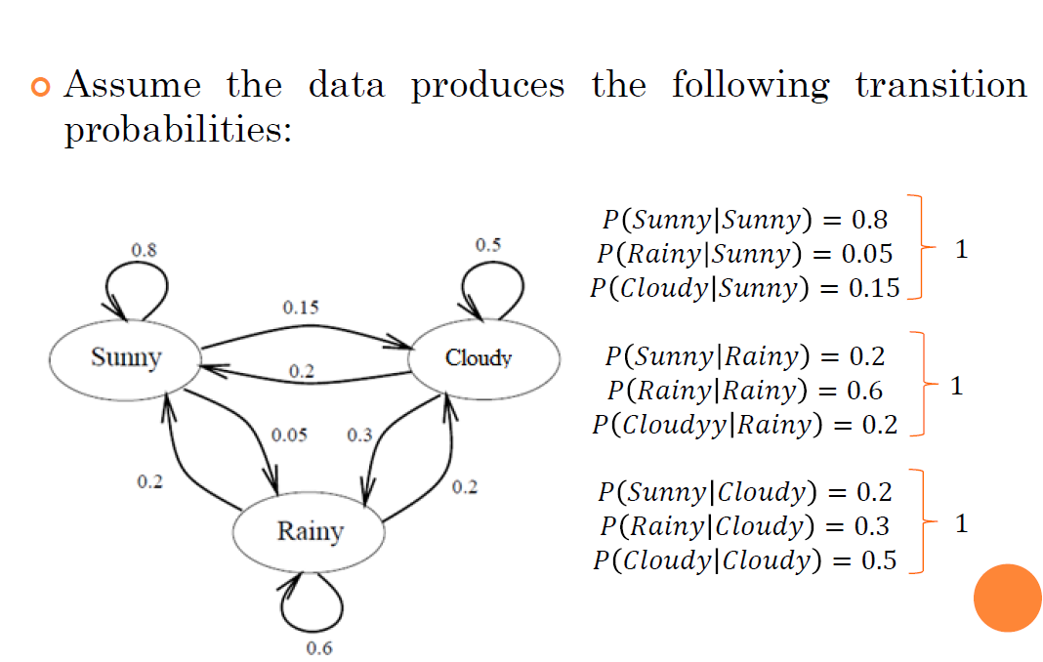

Slide 8
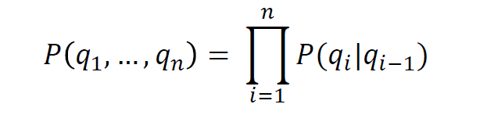
Let’s say we have a sequence: Sunny, Rainy, Cloudy, Cloudy, Sunny, Sunny, Sunny, Rainy, ….; so, in a day we can be in any of the three states.
We can use the following state sequence notation: 𝑞₁,
𝑞₂, 𝑞₃, 𝑞₄, 𝑞₅, … . ., where 𝑞_{𝑖} 𝜖 {𝑆𝑢𝑛𝑛𝑦, 𝑅𝑎𝑖𝑛𝑦, 𝐶𝑙𝑜𝑢𝑑𝑦}.
In order to compute the probability of tomorrow’s
weather we can use the Markov property:

Slide 9
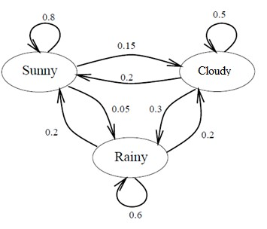
Exercise 1: Given that today is Sunny, what’s the probability that tomorrow is Sunny and the next day Rainy?
𝑃 𝑞₂, 𝑞₃ 𝑞₁ = 𝑃 𝑞₂ 𝑞₁ 𝑃 𝑞₃ 𝑞₁, 𝑞₂
= 𝑃 𝑞₂ 𝑞₁ 𝑃 𝑞₃ 𝑞₂
= 𝑃 𝑆𝑢𝑛𝑛𝑦 𝑆𝑢𝑛𝑛𝑦
= 0.8 (0.05)
= 0.04
𝑃 𝑅𝑎𝑖𝑛𝑦 𝑆𝑢𝑛𝑛𝑦

Slide 10
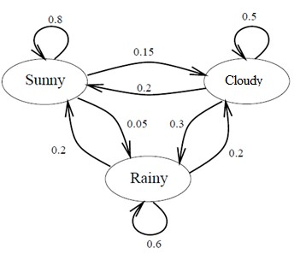
Exercise 2: Assume that yesterday’s weather was Rainy, and today is Cloudy, what is the probability that tomorrow will be Sunny?
𝑃(𝑞₃|𝑞₁, 𝑞₂) = 𝑃 𝑞₃ 𝑞₂
= 𝑃 𝑆𝑢𝑛𝑛𝑦 𝐶𝑙𝑜𝑢𝑑𝑦
= 0.2

Slide 11
Exercise 3: Assume that today weather is Cloudy, and Yesterday was Rainy, what is the probability that tomorrow will be Sunny?

Slide 12
Exercise 4: What is the probability of given sequence S,R,R,R,C,C

Slide 13
WHAT IS A MARKOV MODEL?
A Markov Model is a stochastic model which models
temporal or sequential data, i.e., data that are ordered.
It provides a way to model the dependencies of current
information (e.g. weather) with previous information.
It is composed of states, transition scheme between states, and emission of outputs (discrete or continuous).
Several goals can be accomplished by using Markov models:
Learn statistics of sequential data.
Do prediction or estimation.
Recognize patterns.

Slide 14
WHAT IS A HIDDEN MARKOV MODEL (HMM)?
A Hidden Markov Model, is a stochastic model where the states of the model are hidden. Each state can emit an output which is observed.
Imagine: You were locked in a room for several days and you were asked about the weather outside. The only piece of evidence you have is whether the person who comes into the room bringing your daily meal is carrying an umbrella or not.
What is hidden? Sunny, Rainy, Cloudy
What can you observe? Umbrella or Not

Slide 15
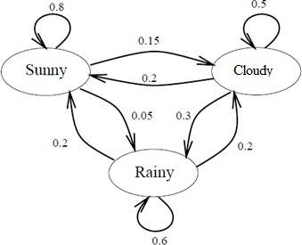
MARKOV CHAIN VS. HMM
Markov Chain:

Slide 16
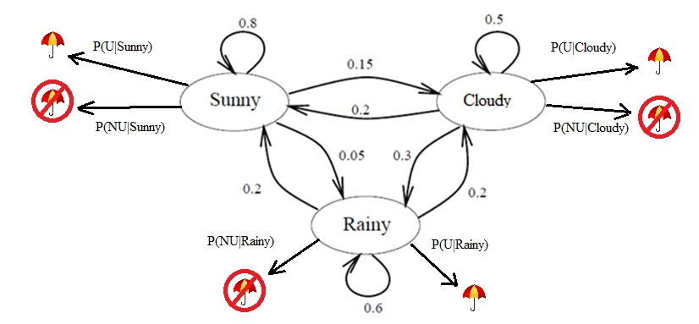
HMM:
U = Umbrella
NU = Not Umbrella

Slide 17
Let’s assume that 𝑡 days had passed. Therefore, we will have an observation sequence O = {𝑜₁, … , 𝑜_{𝑡}} , where 𝑜_{𝑖} 𝜖 𝑈𝑚𝑏𝑟𝑒𝑙𝑙𝑎, 𝑁𝑜𝑡 𝑈𝑚𝑏𝑟𝑒𝑙𝑙𝑎 .
Each observation comes from an unknown state. Therefore, we will also have an unknown sequence
𝑄 = 𝑞₁, … , 𝑞_{𝑡} , where 𝑞_{𝑖} 𝜖 𝑆𝑢𝑛𝑛𝑦, 𝑅𝑎𝑖𝑛𝑦, 𝐶𝑙𝑜𝑢𝑑𝑦 .
We would like to know: 𝑃(𝑞₁, . . , 𝑞_{𝑡}|𝑜₁, … , 𝑜_{𝑡}).

Slide 18
HMM MATHEMATICAL MODEL
From Bayes’ Theorem, we can obtain the probability
for a particular day as:
₌ 𝑃 𝑜_{𝑖} 𝑞_{𝑖} 𝑃(𝑞_{𝑖})
𝑃 𝑞 𝑜
𝑖 𝑖
𝑃(𝑜_{𝑖})
For a sequence of length 𝑡:
₌ 𝑃 𝑜₁, … , 𝑜_{𝑡} 𝑞₁, … , 𝑞_{𝑡} 𝑃(𝑞₁, … , 𝑞_{𝑡})
𝑃 𝑞₁, … , 𝑞_{𝑡} 𝑜₁, … , 𝑜_{𝑡}
𝑃(𝑜₁, … , 𝑜_{𝑡})

Slide 19
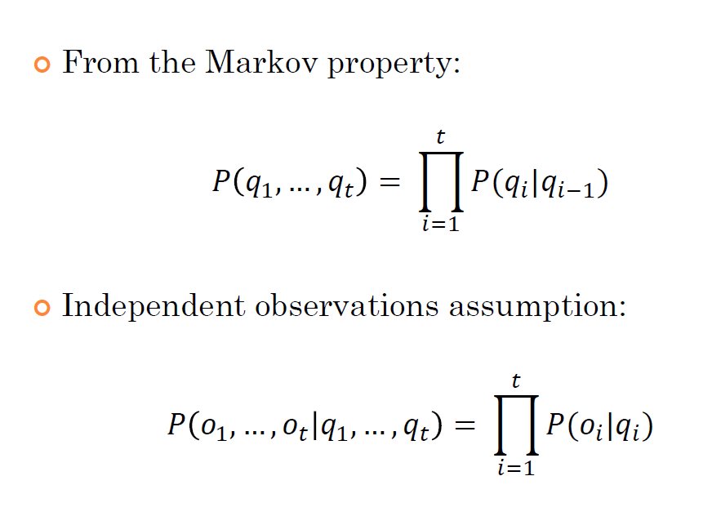

Slide 20
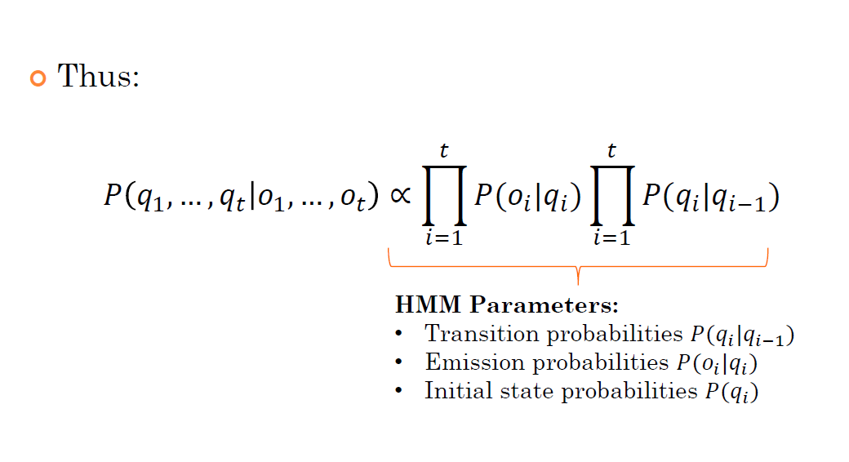

Slide 21
HMM PARAMETERS
A HMM is governed by the following parameters:
λ = {𝐴, 𝐵, 𝜋}
State-transition probability matrix 𝐴
Emission/Observation/State Conditional Output probabilities 𝐵
Initial (prior) state probabilities 𝜋
Determine the fixed number of states (𝑁):
𝑆 = 𝑠₁, … , 𝑠_{𝑁}

Slide 22
State-transition probability matrix:
^{𝑎}11 ^{𝑎}12
^{𝑎}21 ^{𝑎}23
. .
. .
. .
^{𝑎}𝑁1^{𝑎}𝑁2
. .
. .
.
.
.
.
^{𝑎}1𝑁
^{𝑎}2𝑁
.
.
.
^{𝑎}𝑁𝑁
∑𝑁
𝑎_{𝑖𝑗} = 1 (Each row/Outgoing arrows)
𝑗=1
A =
𝑎 = 𝑃(𝑞_{𝑡} = 𝑠_{𝑗} |𝑞_{𝑡−1} = 𝑠_{𝑖}), 1 ≤ 𝑖, 𝑗 ≤ 𝑁
𝑖𝑗
.
. . .
^{𝑎}𝑖𝑗
≥ 0
^{𝑎}𝑖𝑗
→ 𝑇𝑟𝑎𝑛𝑠𝑖𝑠𝑖𝑡𝑜𝑛 𝑝𝑟𝑜𝑏𝑎𝑏𝑖𝑙𝑖𝑡𝑦 𝑓𝑟𝑜𝑚 𝑠𝑡𝑎𝑡𝑒 𝑠_{𝑖} 𝑡𝑜 𝑠_{𝑗}
^{𝑎}𝑖𝑗
𝑠_{𝑖}
𝑠_{𝑗}

Slide 23
Emission probabilities: A state will generate an observation (output), but a decision must be taken according on how to model the output, i.e., as discrete or continuous.
Discrete outputs are modeled using pmfs.
Continuous outputs are modeled using pdfs.

Slide 24
Discrete Emission Probabilities:
Observation Set: 𝑉 = {𝑣₁, … , 𝑣_{𝑊}}
𝑏₁ 𝑣₁
𝑠_{𝑖}
𝑏_{𝑖} 𝑣_{𝑘}
= 𝑃 𝑜_{𝑡} = 𝑣_{𝑘} 𝑞_{𝑡} = 𝑠_{𝑖} ,
1 ≤ 𝑘 ≤ 𝑊
𝑣₁
𝑏 𝑣
…
𝑏 𝑣
1 2
1 𝑊
𝑏₁(𝑣₁) 𝑏₁(𝑣₂)
𝑏₂(𝑣₁) 𝑏₂(𝑣₂)
. .
. .
. .
. .
. 𝑏₁(𝑣_{𝑊})
. 𝑏₂(𝑣_{𝑊})
.
.
.
. 𝑏_{𝑁}(𝑣_{𝑊})
𝑣₂
𝑣_{𝑊}
𝐵 =
.
. .
𝑏_{𝑁}(𝑣₁)𝑏_{𝑁}(𝑣₂) .
.
.

Slide 25
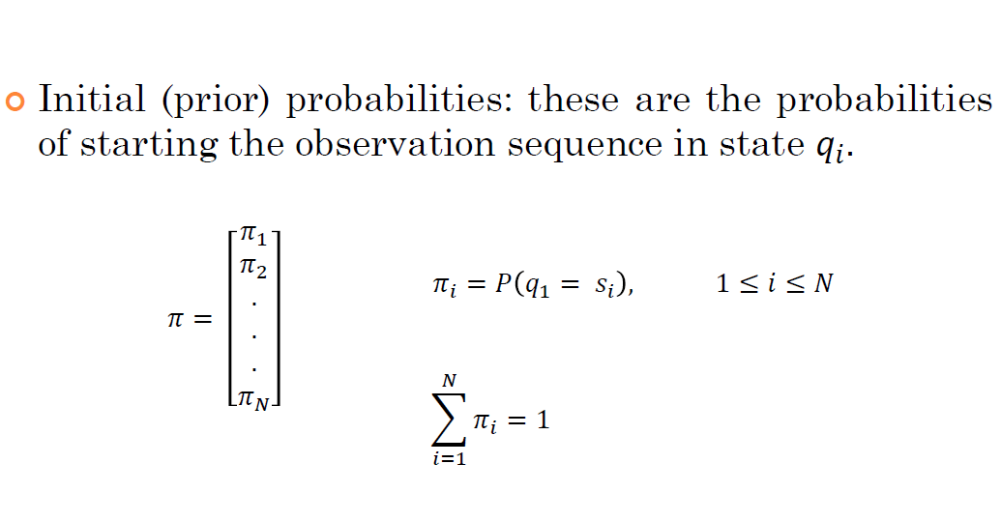

Slide 26
HMM components: Here (X_{i} = Q_{i} ) and (E_{i} = O_{i})

Slide 27
Three Problems of HMM

Slide 28
HMM Example

Slide 29
Markov model with Graz weather with state transition probabilities

Slide 30
Probability of Umbrella

Slide 31
Example1

Slide 33
Example 2

Slide 34
ICE Cream Problem
Imagine that you are a climatologist in the year 2799 studying the history of global warming. You cannot find any records of the weather in Amaravati, for the summer of 2021, but you do find Jason Eisner’s diary, which lists how many ice creams Jason ate every day that summer.
Our goal is to use these observations to estimate the temperature every day.
We’ll simplify this weather task by assuming there are only two kinds of days: cold (C) and hot (H).
So the Eisner task is as follows: Given a sequence of observations O (each an integer representing the number of ice creams eaten on a given day) find the ‘hidden’ sequence Q of weather states (H or C) which caused Jason to eat the ice cream.
Figure A.2 shows a sample HMM for the ice cream task.
The two hidden states (H and C) correspond to hot and cold weather, and the observations (drawn from the alphabet O = {1,2,3}) correspond to the number of ice creams eaten by Jason on a given day

Slide 35
ICE Cream Problem

Slide 36
Question ???
Compute the probability of ice-cream events 3 1 3 instead by summing over all possible weather sequences, weighted by their probability.
First, let’s compute the joint probability of being in a particular weather sequence Q and generating a particular sequence O of ice-cream events.

Slide 37
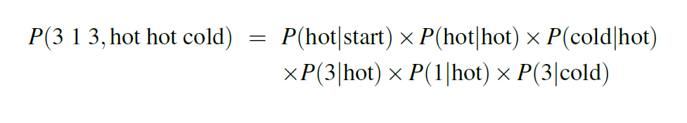
The computation of the joint probability of our ice-cream observation 3 1 3 and one possible hidden state sequence hot hot cold is shown below

Slide 38
N = No. of hidden states = 2
T = Given no.of observations = 3
M = N^{T} = 2³ = 8 possibilities (HHC, CCC, HCH… )
N= 7
T = 10
N^{T} = 7¹⁰

Slide 39
How to solve this ?

Slide 40
Decoding: The Viterbi Algorithm

Slide 41
Viterbi Algorithm

Slide 46
Real HMM Examples
Speech recognition HMMs:
Observations are acoustic signals (continuous valued)
States are specific positions in specific words (so, tens of thousands)
Machine translation HMMs:
Observations are words (tens of thousands)
States are translation options
Robot tracking:
Observations are range readings (continuous)
States are positions on a map (continuous)

